Slide 1

Apache Log4j
Dima Ionut Daniel

Slide 2
Contents
What is Log4j?
Why Logging ?
Log4j Features
Architecture
Logger Levels
Configuration
Log4j Core
Appender
Layout
Filter
ObjectRenderer
Logging APIs
Conclussion
Bibliography

Slide 3

What is Log4j?
Log4j is a reliable, fast and flexible logging framework(API) written in Java
Log4j is distributed under the Apache Software License.
Log4j has been ported to the C, C++, C#, Perl, Python, Ruby, and Eiffel languages.

Slide 4
Why Logging?
Logging generally means some way to indicate the state of the system at runtime.
We all use logging during development to debug and test our applications/modules.
We want to produce logging that is informative and effective.
Logging important action points:
It’s systematic → what information to log
It’s controlled →log level can be changed with configuration
Represents application state → aim to represent the internal state of the system

Slide 5
Why Logging? (cont.)
Logging within an application can offer following benefits:
Quick debugging:
Easy maintenance
History
Diagnostic
Cost and time savings
Logging can introduce also the following disadvantages:
Adds runtime overhead(I/O operations) due to generation of logging information
Badly produce logging information can cause confusion
Badly written logging code can affect application’s performance
Logging requires planning ahead, as adding logging code at a late state of development is time consuming and hard

Slide 6
Log4j Features
Log4j features
- optimized for speed
- thread-safe
- supports multiple output appenders per logger
- supports internationalization
- based on a named logger hierarchy
- uses multiple levels: ALL, TRACE, DEBUG, INFO, WARN. ERROR, FATAL
- behaviours can be set at runtime using configuration file.
- format of the output log can be changed by extending the Layout class.

Slide 7
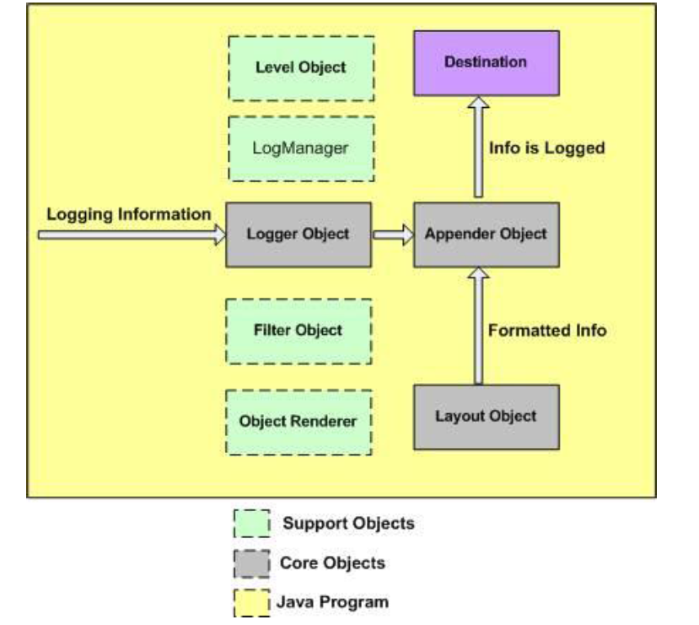
Architecture

Slide 8
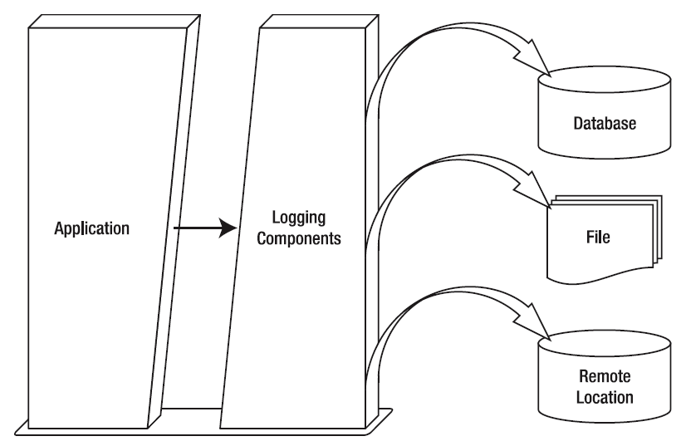
Architecture
From the architectural point of view, software application modules and logging components reside in two separate layers.
The logging components receive the logging request and publish the logging information at preferred destinations.

Slide 9
Architecture (cont.)
There are two type of objects available with Log4j framework:
- Core Objects: mandatory objects of the framework and required to use the framework.
- Logger: top level layer responsible for capturing logging information
- Layout: objects responsible for formating logging information in different styles.
- Appender: lower level layer responsible for publishing logging information to various destinations.
- Support Objects: optional objects of the framework and support core objects to perform addition but important tasks.
- Level: defined the granularity and priority of any logging information.
- Filter: analyzes the logging information and make further decisions
- ObjectRenderer: provides String representation of different objects passed to logging framework.
- LogManager: manages logging framework responsible for reading initial configuration parameters.

Slide 10
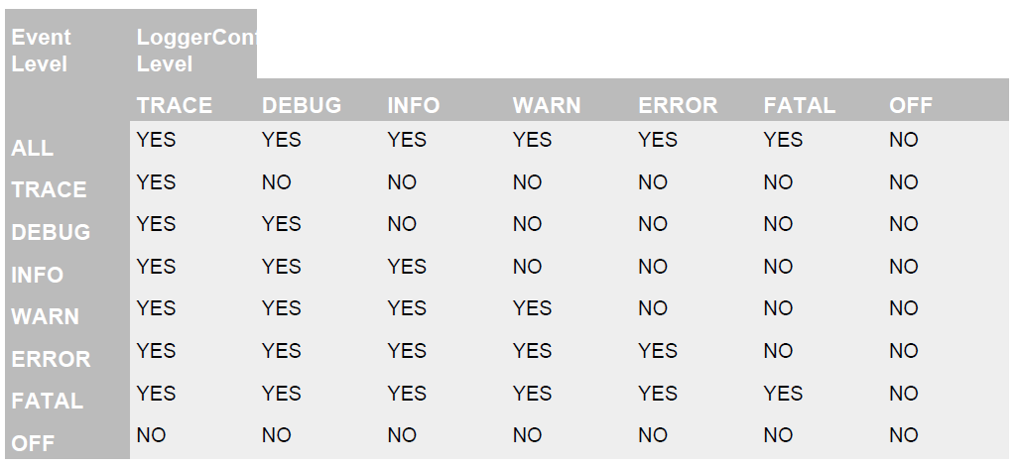
Logger Levels
Logger levels

Slide 11
Logger Levels (cont.)
A log request of level p in a logger with level q, is enabled if p >= q.
This rule is at the heart of log4j.
For the standard levels, we have ALL < DEBUG < INFO < WARN < ERROR < FATAL < OFF

Slide 12
Configuration
The log4j.properties file is a log4j configuration file which keeps properties in key-value pairs.
By default, the LogManager looks for a file named log4j.properties in the CLASSPATH.
If we want to provide another log4j file name we need to supply a line argument:
-Dlog4j.configuration=“<file_name>”
Each Appender object has different properties associated:
layout: conversion pattern
target: console, file, or another item
level:
threshold: ignores any logging messages that have a level lower than the threshold level.
filter: custom filter object

Slide 13
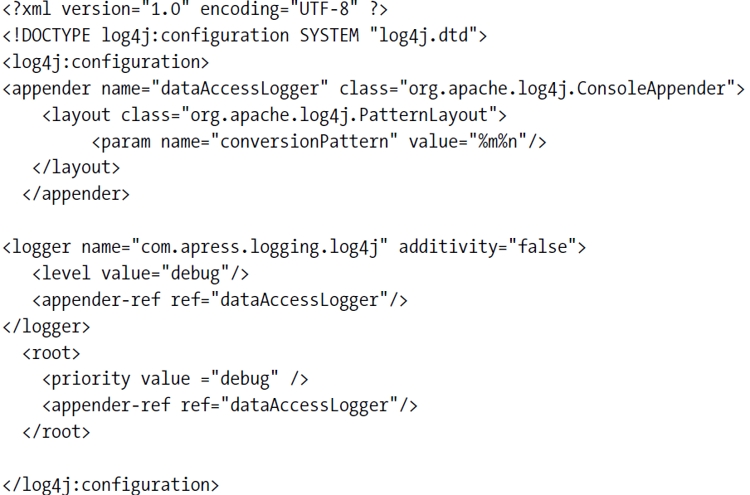
Configuration (cont.)
With Log4j it’s possible to define configuration parameters in an XML file and pass that file to the application at startup. The XML can be validated using the log4j.dtd.

Slide 14
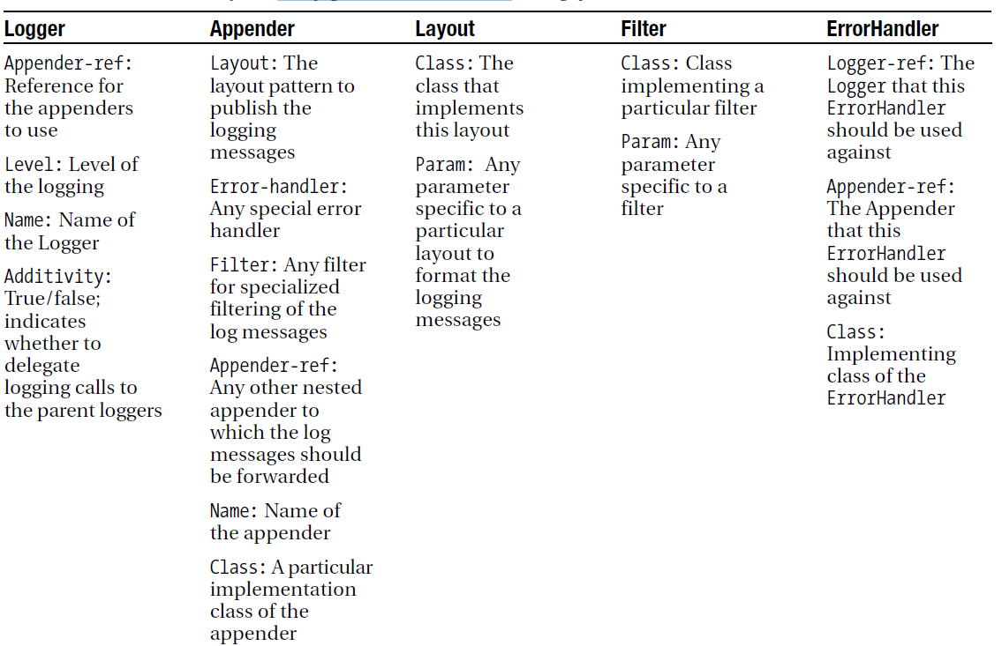
Configuration (cont.)

Slide 15
Configuration (cont.)
Log4j accepts 3 separate VM parameters in the initialization process:
log4j.configuration → specifies the log4j configuration file
log4j.configurationClass → specifies customized initialization class to use instead of the default LogManager.
log4j.defaultInitOverride → overrides default initialization process.
log4j.debug → variable that indicates whether the log4j internal logging should be enabled.
Log4j can be configured programmatically using PropertyConfigurator object or BasicConfigurator.

Slide 16
Log4j Core
Once we obtain an instance of a named logger, we can use several methods of the logger to log messages.
Usual methods: debug, error, fatal, info, warn, trace.
Logger object provides methods for logging messages in a different languages using the ResourceBundle object. The ResourceBundle object is set using the setResourceBundle method.
The methods that are using the ResourceBundle are:
l7dlog(Priority p, String key, Throwable t)
l7dlog(Priority p, String key, Object params[], Throwable t)
Generic logging can be achieved using the log method.

Slide 17
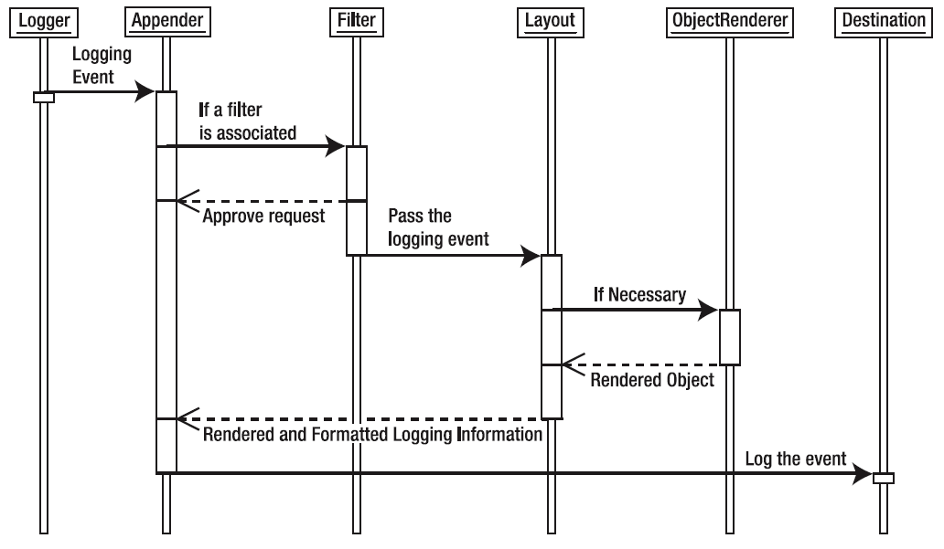
Log4j Core (cont.)

Slide 18
Log4j Core (cont.)
LogManager class manages the creation and storage of each named logger created within the application.
It uses a helper class Hierarchy to store the reference of each Logger object created.
NDC = Nested Diagnostic Context
The majority of real-life complex distributed systems are multithreaded.
The NDC class in log4j uses the methods like pop, push, remove to manage the information in the NDC stack.
All the methods in the NDC class are static.
The NDC is managed per thread as a stack of contextual information.
Message Diagnostic Context (MDC) is a mechanism to store client-specific data using the java.util.Map format.
The MDC class provides the methods get, put, remove to manipulate the key and the value stored within the Map.

Slide 19
Appender
Appender objects are primarily responsible for printing logging messages to different destinations such as consoles, files, sockets, etc.
Appender objects can have Filter objects associated with them to make further decisions about the logging of a particular message.
It's a major benefit that Appender objects are flexible.
It's possible to create Appender objects to write to a database and JMS to achieve a distributed logging framework.

Slide 20
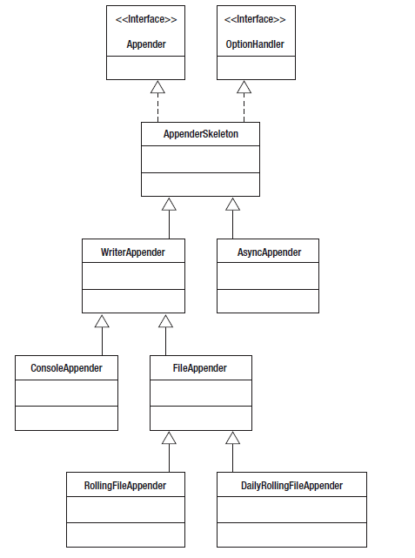
Appender (cont.)
The addAppender() method adds an Appender to the Logger object.
Each logging request to a logger will be forwarded to all the Appender objects associated with it.
We can turn the additivity feature off by setting the additivity flag to false by calling the setAdditivity(Boolean value).

Slide 21
Appender (cont.)
The LoggingEvent class encapsulates all relevant logging information like:
fully qualified named caller class
level of logging message
message itself
Logger instance
Timestamp
optional Throwable instance
The Logger creates an instance of the LogginEvent object before dispatching it to the Appenders.
The Logger calls the doAppend(LoggingEvent event) method of the Appender objects.
The doAppend() method performs vital operations:
compares logging level with the threshold level
checks if the Appender is open
checks if any Filter objects are associated

Slide 22
Appender (cont.)
WriterAppender:
extends AppenderSkeleton
writes to a Writer or OutputStream object
ConsoleAppender:
writes logging information to either System.out or System.err
FileAppender:
extends WriterAppender
writes information to a file
RollingFileAppender:
extends FileAppender
writes to a file, and can roll over to a seconday file when the primary file reaches a certain size(default 10MB).

Slide 23
Appender (cont.)
DailyRollingFileAppender:
extends FileAppender
uses a date pattern to roll over the files(Default: '.' yyyy-MM-dd)
AsyncAppender:
extends AppenderSkeleton
uses a bounded buffer to store logging events
once the buffer it's full it will send logging events to specific Appender objects.
JDBCAppender:
extends AppenderSkeleton
stores logging data into databases
JMSAppender:
extends AppenderSkeleton
used for sending JMS messages to Topic/Queue

Slide 24
Appender (cont.)
SocketAppender:
extends AppenderSkeleton
writes logging information to TCP/IP based raw socket connections.
NTEventLogAppender:
extends AppenderSkeleton
send log information to the event log of a particular OS.
SMTPAppender:
extends AppenderSkeleton
sends logging information using SMTP.
TelnetAppender:
extends AppenderSkeleton
opens a server socket connection to a port and listens for any connection made to the same port.
soon as a connection signal arrives, it adds the connection source information to a buffer.

Slide 25
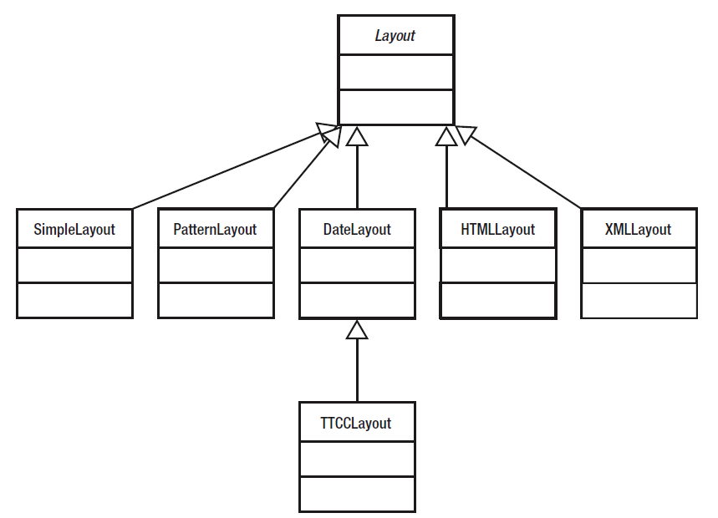
Layout
Apache log4j provides various Layout objects, each of which can format logging data according to various layouts.
All Layout objects receive a LoggingEvent object from the Appender objects.

Slide 26
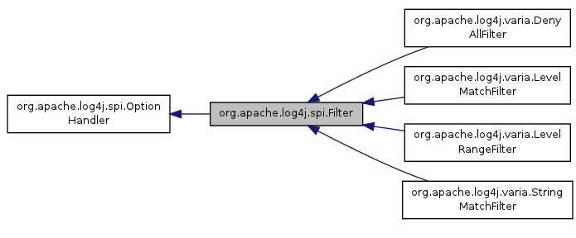
Filter
The Filter objects help to filter logging requests by analyzing the information encapsulated within the LoggingEvent object.
It defines an abstract method: public int decide(LoggingEvent event).
With LevelRangeFilter, we can specify the lower range and the upper range of logging levels that the logging framework should approve.

Slide 27
ObjectRenderer
The logging information that we intend to publish can be of various types and in various formats
Layout objects call the ObjectRenderer to obtain a String representation of the Object content before they attempt to format the Object argument passed to the Logger.
If the message argument passed to the Logger is a String, no ObjectRenderer is required to convert the message, and the Layout object processes the message.

Slide 28
Logging APIs
There are a few Java-based logging APIs available for use.
JDK Logging API
java.util.logging package → originated from JSR 47.
Apache Log4j
Open source logging API
Commons Logging API
API created by Apache.

Slide 29
Conclussion
PROS:
Log4j is optimized for speed
Log4j is based on a named logger hierarchy
Log4j is thread-safe
Log4j supports multiple output appenders per logger.
The format of the log output can be easily changed by extending the Layout class.
Logging behavior can be set at runtime using a configuration file.
CONS:
Asynchronous logging facility is not provided

Slide 30

Bibliography
Apress - Pro Apache Log4j
www.tutorialspoint.com/log4j/log4j_tutorial.pdf

Slide 31
Questions ?

